Slide 1


Slide 2

Long-term monitoring of users' condition using Smart Walker
Presented By
Engr.nazia ejaz
Supervised BY: Dr.saad jawaid khan
Co - supervisor: dr. joaquín Ballesteros
`

Slide 3
Contents
Introduction/Background
Literature Review
Problem Statement
Research Project Objectives
Proposed Methodology/Block Diagram
Preliminary Results
Conclusion
References

Slide 4
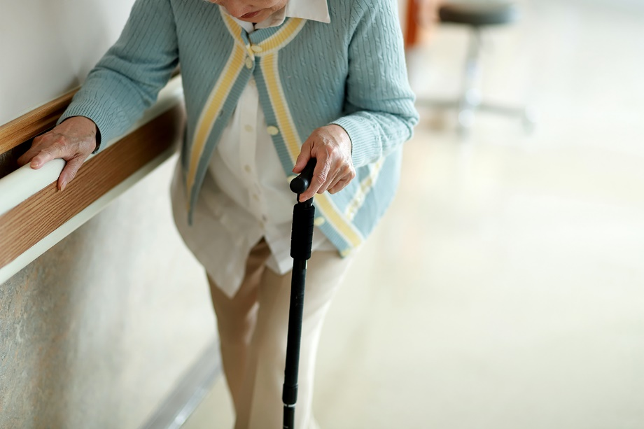
Introduction
Gait analysis is the evaluation of the manner or style of walking [1].
Gait analysis is used to assess and treat individuals with conditions affecting their ability to walk [2].
Mobility is a prerequisite for the vast majority of everyday activities [3].
Ageing and many pathologies invoke changes in walking speed and stability [2], while 30% of the aged population is reported to have fallen every year.
Notes:
Mobility is a prerequisite for the vast majority of everyday activities, and being able to move around outdoors contributes to societal participation and is known to reduce depression and social stigma .
The worldwide population aged over 65 rises exponentially according to recent reports of the United Nations [1]. Amongst others the mobility problems prevail in the elder society. Ageing and many pathologies invoke changes in walking speed and stability [2], while 30% of the aged population is reported to have fallen every year. Especially, changes in gait speed are related to the functional independence and mobility impairment of the elderly [3], and are closely connected to fall incidents Problems related to the gait are increasing due to the major factor of chronic health problems: Parkinson [5], hemiplegic [6], paraplegia [7] or stroke [6].

Slide 5
Pathologies Affecting Gait Pattern
Pathologies.docx

Slide 6
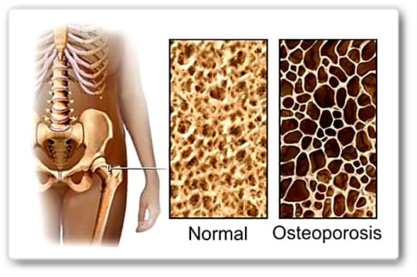
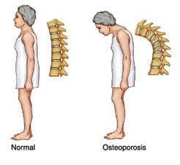
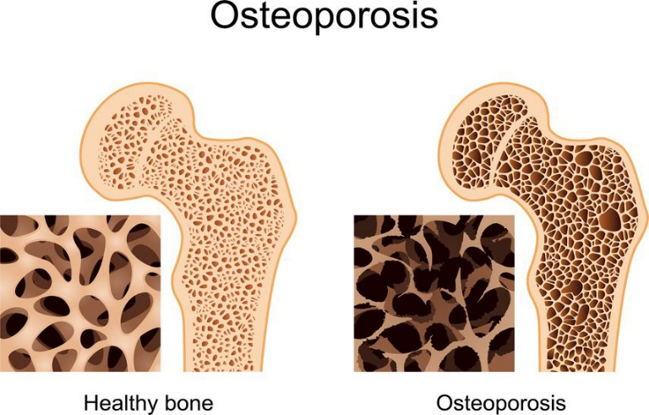
Introduction
Osteoporosis:
Notes:
Osteoporosis is a skeletal condition characterized by decreased density (mass/volume) of normally mineralized bone. The reduced bone density leads to decreased mechanical strength, thus making the skeleton more likely to fracture

Slide 7
Introduction
Osteoporosis is a major health problem of aging community [4].
Osteoporosis is also associated with decreased strength and deficits of gait and balance [4].
It is reported that the global population of aged 60 or older was 962 million in 2017 and this number is expected to double with a projected number nearly 2.1 billion by 2050 [1].
It has been estimated that the number of women over the age of 65 years has increases from 188 million in 1990 to 325 million in 2015. According to International Osteoporosis Foundation, 1 out of 8 males and 1 out of 3 females in India suffers from osteoporosis, making India one of the largest affected country in the world [2].
Notes:
It has been estimated that the number of women over the age of 65 years has increases from 188 million in 1990 to 325 million in 2015. According to International Osteoporosis Foundation, 1 out of 8 males and 1 out of 3 females in India suffers from osteoporosis, making India one of the largest affected country in the world5 . The incidence of hip fracture is 1 woman to 1 man in India6 . In most Western countries, while the peak incidence of osteoporosis occurs at about 70-80 years of age, in India it may afflict those 10-20 years younger, i.e. at age of 50-607 years.

Slide 8
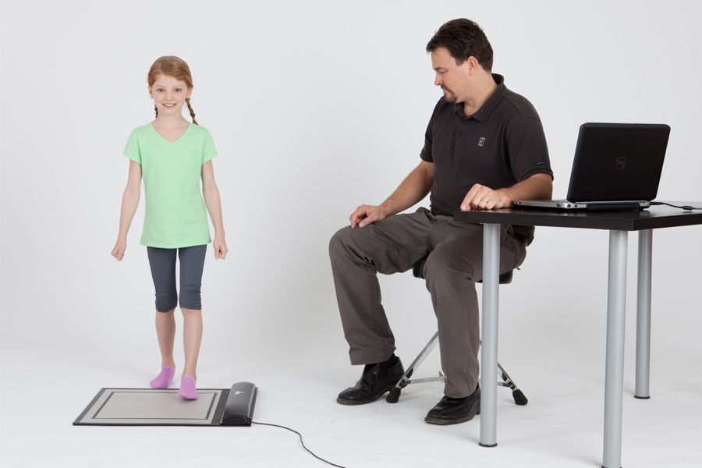
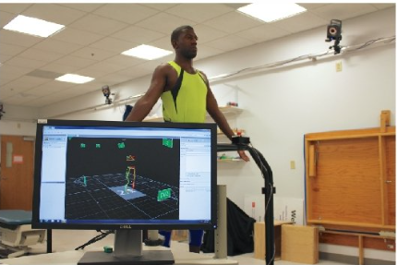
Major Types of Gait Assessments
Gait Analysis
Qualitative Gait Assessment
Quantitative Gait Assessment

Slide 9

Qualitative Assessment
Clinical Tests:
10-meter walk test (10mWT)
6-minute walk test (6MWT)

Slide 10
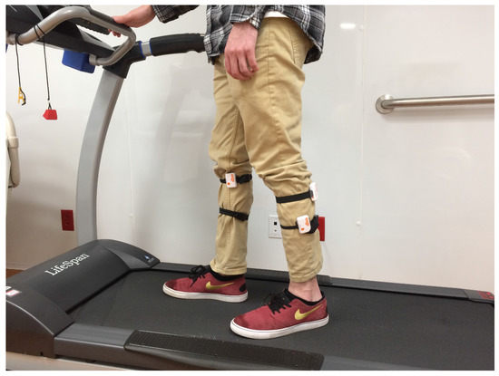
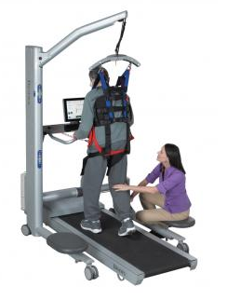
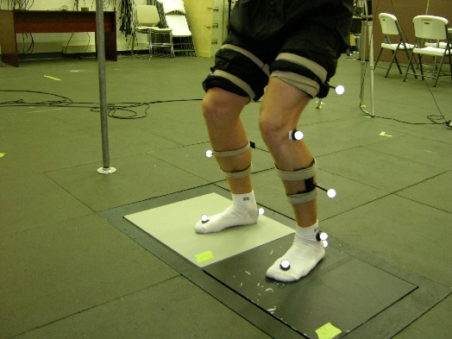
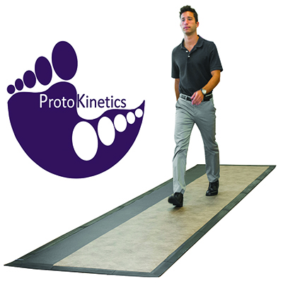
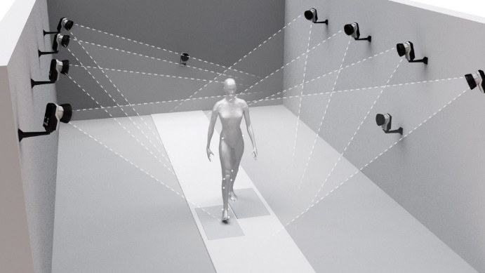
Existing Technologies
Force plates
Body-mounted accelerometers
Instrumented treadmill
Instrumented walkway

Slide 11
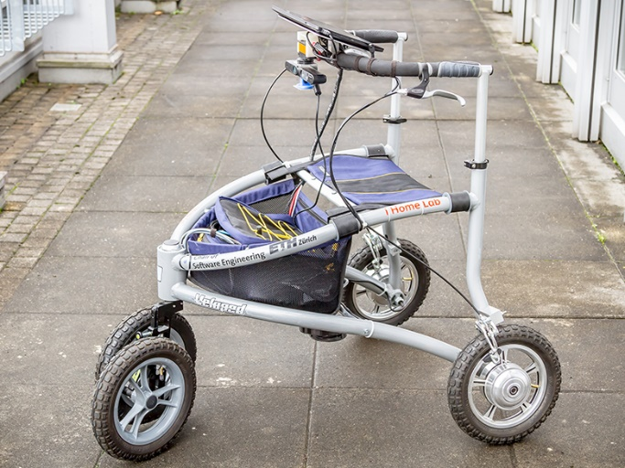
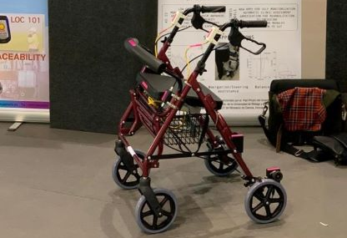
Introduction
Measuring gait in people with disabilities.
Measuring everywhere
Measuring every time
Economical and portable systems
ETH University
Malaga University
Notes:
So you can install Onboard sensor on the platform. This is the perfect solution because the user need to use their platform to walk, so they never forget to use the device to measure their gait. You will obtain a 24 four 360 days system to monitor their gait. So trends in their condition will be obtain easily.
According to the report of the year 2018 of the World Health Organization, it is declared that more than 15% of the world’s population has some disability [3]. Moreover, it is reported that up to 190 million adults may suffer from the complications and problems of lower limb disabilities of gait patterns [3]. So this solution can be used for a lot of users.
https://ethz.ch/en/news-and-events/eth-news/news/2016/02/smart-walking-aid%20.html

Slide 12
Problem Statement
Wheeled walkers are used for automatic gait monitoring ,but there is a risk of fall related injuries .
Lack of availability of economical gait assessment techniques for patients with neurological disorders, fractures and age-related disorders which affects gait.
Continuously providing support and gait monitoring devices are not available in Pakistan.

Slide 13
Project Objectives
To design a gait retraining device for automatic assessment during rehabilitation.
To validate the device on participants with osteoporosis.
To classify healthy verus osteoporotic participants data with the help of ML classifier.

Slide 14
Methodology

Slide 15
Methodology
Device Designing
Device Testing
Data Collection
Data Analysis
Data Classification

Slide 16
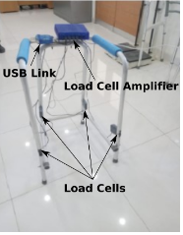
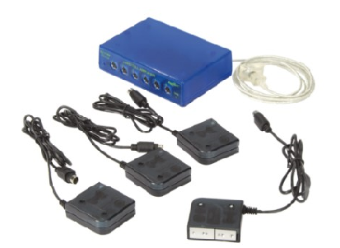
Methodology

Slide 17
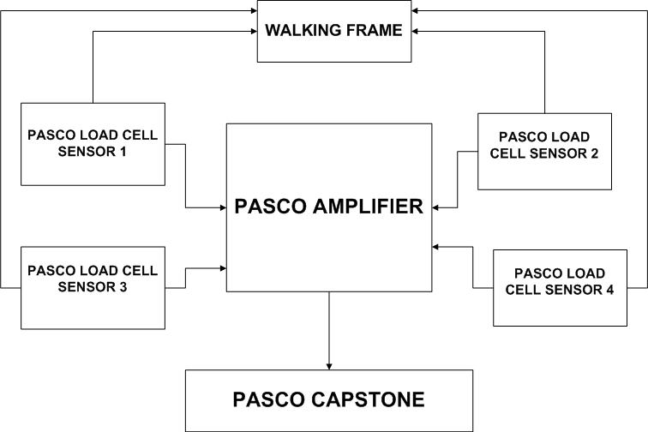
Block Diagram of Walker

Slide 18
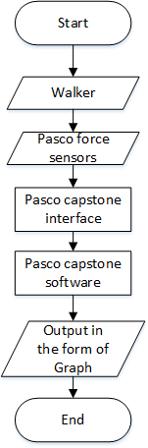
Flow Chart

Slide 19
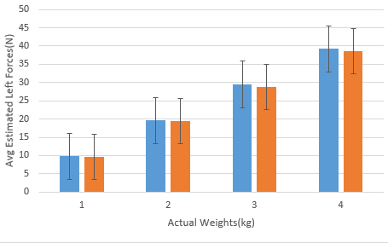
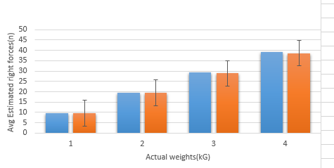
Testing
The testing of sensors were done by using known standard weights .
a) Accuracy of Left Sensor
b) Accuracy of Right Sensor

Slide 20
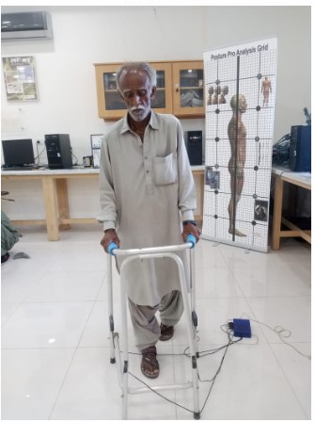
Data Collection: 10-meter walk test
Number of steps
Time to complete the test.
Other gait spatiotemporal parameters were calculated for e.g., cadence, gait speed, step length, etc.
Data is collected from Biomechanics & Rehabilitation Engineering Lab, Ziauddin University, Faculty of Engineering, Science, technology & Management ,Rehabilitation Lab at the College of Rehabilitation Sciences, Ziauddin University, Anmol Zindagi, Gill Shelter Home and Gosha-e-Afiyat old age home.

Slide 21
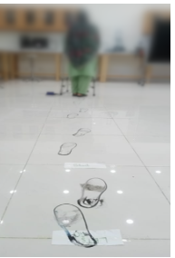
Data Collection Protocols
20 Healthy volunteers and 20 osteoporotic volunteers, having no any degenerative disese are selected.
10m smooth titled floor is selected for the participants walk using walker.
Participants were asked to wet their shoes in colored solution before start to walk.

Slide 22
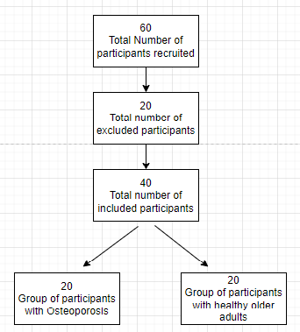
Participants Information
Number of participants
Total 60 volunteers were participated in this test .

Slide 23
Participants Information
Number of males: 11 Healthy and 10 osteoporotic males .
Number of females: 9 Healthy and 10 osteoporotic females.
Ages: Age range is from 50 to 90.
BMI:
Osteoporotic: 22.43 ± 3.45
Healthy: 23.69 ± 3.54
Height:
Osteoporotic: 5’’31 ± 0.26
Healthy: 5’’41 ± 0.48

Slide 24
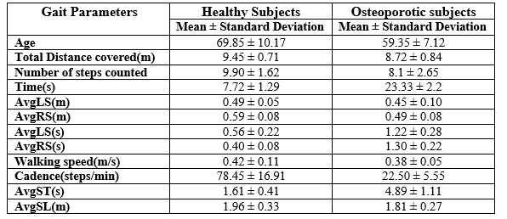
Spatiotemporal Gait Parameters

Slide 25
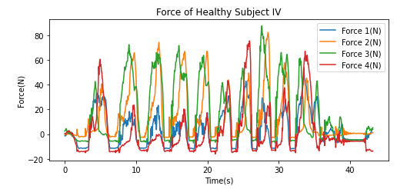
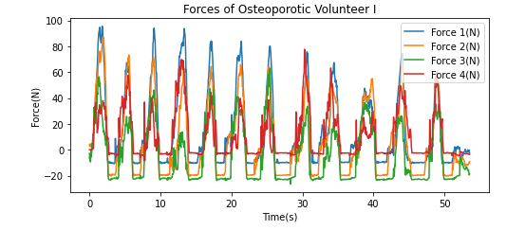
Forces subjects, toward a gait analysis

Slide 26
References
[1]Item-Glatthorn, Julia F, and Nicola A Maffiuletti. “Clinical assessment of spatiotemporal gait parameters in patients and older adults.” Journal of visualized experiments : JoVE ,93 e51878. 7 Nov. 2014, doi:10.3791/51878
[2] J. B. Morrison, "The mechanics of the knee joint in relation to normal walking," (in eng), J Biomech, vol. 3, no. 1, pp. 51-61, Jan 1970.
[3] K. E. Webster, J. E. Wittwer, and J. A. Feller, "Quantitative gait analysis after medial unicompartmental knee arthroplasty for osteoarthritis," The Journal of Arthroplasty, vol. 18, pp. 751-759, 2003/09/01/ 2003.
[4] N. Kostanjsek, "Use of The International Classification of Functioning, Disability and Health (ICF) as a conceptual framework and common language for disability statistics and health information systems," BMC Public Health, vol. 11, no. 4, p. S3, 2011/05/31 2011.
[5] M. Švehlík, E. B. Zwick, G. Steinwender, W. E. Linhart, P. Schwingenschuh, P. Katschnig, et al., "Gait Analysis in Patients With Parkinson's Disease Off Dopaminergic Therapy," Archives of Physical Medicine and Rehabilitation, vol. 90, pp. 1880-1886, 2009/11/01/ 2009.

Slide 27
References
[6] M. Li, S. Tian, L. Sun, and X. Chen, "Gait Analysis for Post-Stroke Hemiparetic Patient by Multi-Features Fusion Method," Sensors (Basel), vol. 19, no. 7, Apr 11 2019.
[7] A. R. Donati et al., "Long-Term Training with a Brain-Machine Interface-Based Gait Protocol Induces Partial Neurological Recovery in Paraplegic Patients," Sci Rep, vol. 6, p. 30383, Aug 11 2016.
[8] J. Michalak, N. F. Troje, J. Fischer, P. Vollmar, T. Heidenreich, and D. Schulte, "Embodiment of sadness and depression--gait patterns associated with dysphoric mood," (in eng), Psychosom Med, vol. 71, no. 5, pp. 580-7, Jun 2009.
[9] T. A. L. Wren, N. Y. Otsuka, R. E. Bowen, A. A. Scaduto, L. S. Chan, M. Sheng, et al., "Influence of gait analysis on decision-making for lower extremity orthopaedic surgery: Baseline data from a randomized controlled trial," Gait & Posture, vol. 34, pp. 364-369, 2011/07/01/ 2011.

Slide 28
References
[10]. Tinetti ME , Richman D , Powell L . Falls efficacy as a measure of fear of falling . J Gerontol. 1990 ; 45 : P239 – 43 .
[11]. Scheffer AC , Schuurmans MJ , van Dijk N , van der Hooft T , de Rooij SE . Fear of falling: Measurement strategy, prevalence, risk factors and consequences among older persons . Age Ageing. 2008 ; 37 : 19 – 24 .
[12]. Kirkwood RN , de Souza Moreira B , Vallone ML , Mingoti SA , Dias RC , Sampaio RF . Step length appears to be a strong discriminant gait parameter for elderly females highly concerned about falls: A cross-sectional observational study . Physiotherapy. 2011 ; 97 : 126 – 31 .
[13]. Delbaere K , Crombez G , Vanderstraeten G , Willems T , Cambier D . Fear-related avoidance of activities, falls and physical frailty. A prospective community-based cohort study . Age Ageing. 2004 ; 33 : 368 – 73 .
[14]. Maggio D , Ruggiero C , Ercolani S , Macchiarulo MC , Palmari N , Luccioli F , et al . A multi-dimensional questionnaire quantifying quality of life in elderly osteoporotic women: The Italian Triple-Q Osteoporosis Study . Aging ClinExp Res. 2010 ; 22 : 330 – 9 .

Slide 29
References
[15] D. T. Felson, “Osteoarthritis as a disease of mechanics,” Osteoarthritis and Cartilage, vol. 21, no. 1, pp. 10–15, 2013.
[16] G. Bergmann, G. Deuretzbacher, M. Heller et al., “Hip contact forces and gait patterns from routine activities,” Journal of Biomechanics, vol. 34, no. 7, pp. 859–871, 2001.
[17] M. O. Heller, G. Bergmann, G. Deuretzbacher et al., “Musculoskeletal loading conditions at the hip during walking and stair climbing,” Journal of Biomechanics, vol. 34, no. 7, pp. 883–893, 2001.
[18] M. G. Pandy, “Computer modeling and simulation of human movement, "Annual Review of Biomedical Engineering, vol. 3, no. 1, pp. 245–273, 2001.

Slide 30
References
[19]. Runge M, Rehfeld G, Resnicek E (2001) Balance training and exercise in geriatric patients. J Musculoskeletal Neuronal Interact 1:61–65
[20]. Asmussen E (1980) Aging and exercise. Environ Physiol 3:419– 428
[21]. Runge M, Hunter G (2006) Determinants of musculoskeletal frailty and the risk of falls in old age. J Musculoskel Neuronal Interact 6:167–173

Slide 31
Thank You

